Slide 1
Handling Anaphoras in multiple languages in the framework of Geometry Constructions
Pankaj Prateek
Jeetesh Mangwani

Slide 2
Overall Objective
To develop a system that tutors the user on geometry construction problems

Slide 3
Objective
To design and implement an interpreter for geometric construction sentences that
Is language-independent (works for English, Hindi at present)
Receives steps for a geometric construction as input e.g. "Draw a line segment AB of length 4 cm", "केंद्र B और त्रिज्या 5 cm लेकर एक चाप खींचिए जो पहले खींची चाप को C पर काटता हो" etc
Handles anaphoras using the task context
Outputs the geometric figure obtained on executing the given sequence of steps

Slide 4
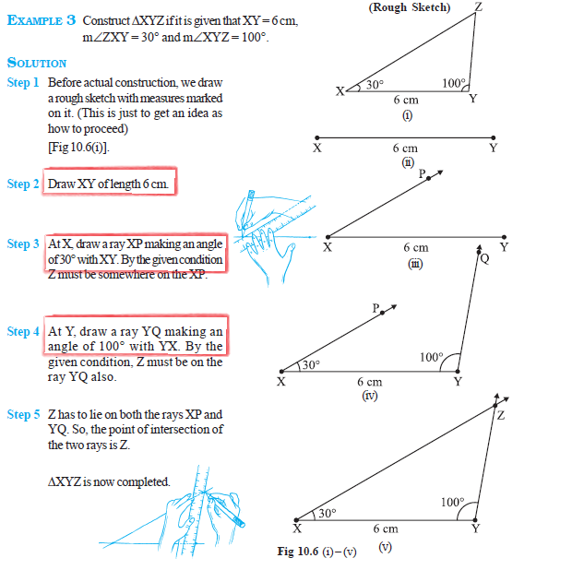
sample problems

Slide 5
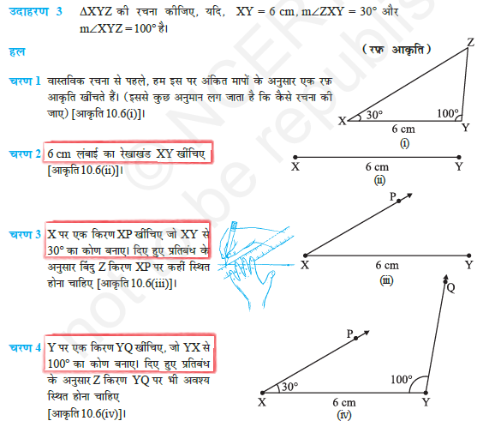
sample problems

Slide 6
Proposed approach
Cross-lingual Alignment
+
Heuristic based parsing

Slide 7
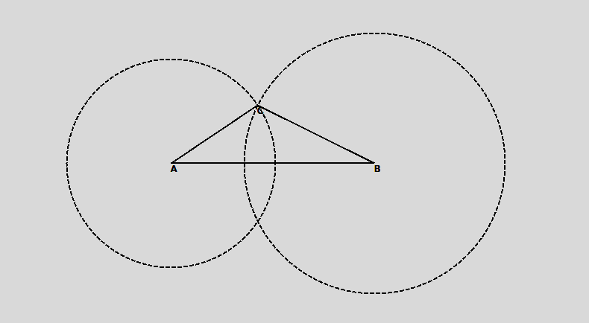
DemoNSTRATIOn
Construct line segment AB of length 7.8 cm
With A and B as centers and radius 4 and 5 cm draw two arcs intersecting each other at C
Join AC
Join BC
7.8 सेमी लम्बाई का एक रेखाखण्ड AB खींचिए
A और B को केंद्र मानकर 4 सेमी और 5 सेमी त्रिज्या लेकर दो चाप बनाइये जो परस्पर C पर काटें
AC को जोड़िये
BC को जोड़िये

Slide 8
Sample Problem
English
Hindi
Example 1:
Construct a triangle ABC, given that AB=5 cm, BC=6 cm and AC=7 cm.
Solution
1. Draw line segment BC of length 6 cm.
2. With B as center, draw an arc of radius 5 cm.
3. With C as center, draw an arc of radius 7 cm.
4. Mark an intersection point of these arcs as A.
5. Join AB.
6. Join AC.
उदहारण 1:
एक त्रिभुज ABC की रचना कीजिये जबकि AB=5 सेमी, BC=6 सेमी और AC=7 सेमी दिया है
हल
1. 6 सेमी लम्बाई का एक रेखाखण्ड BC खींचिए
2. B को केंद्र मानकर और 5 सेमी त्रिज्या लेकर एक चाप खींचिए
3. B को केंद्र मानकर और 7 सेमी त्रिज्या लेकर एक चाप खींचिए
4. इन चापों के प्रतिछेद बिंदु को A से अंकित कीजिये
5. AB को जोड़िये
6. AC को जोड़िये

Slide 9
What is cross-lingual alignment?
Assigns probability to the event that a particular source language token corresponds to a particular target language token

Slide 10
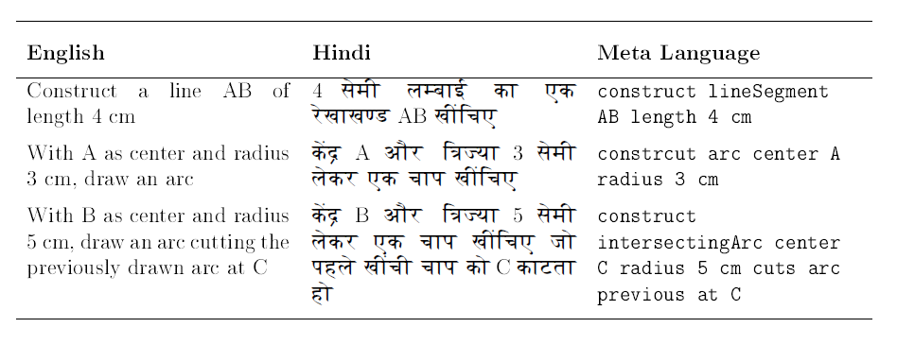
Parallel corpus

Slide 11
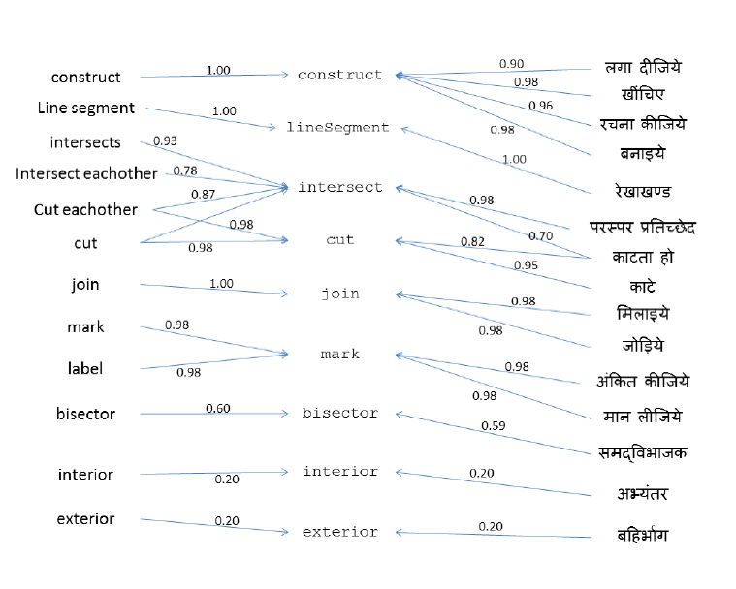
Sample alignment

Slide 12
Heuristics based parsing
1. Type System
2. Proximity
3. Validity of parse

Slide 13
interpreter
English
Input
With A as center and same radius, draw an arc which cuts AB at G
A center same radius construct arc intersecting AB at G
Translation to
Metalanguage
Order differs with language!
A center same radius AB G at intersecting arc construct
Hindi
Input
A को केंद्र मानकर और वही चाप लेकर, AB को G पर काटता हुआ एक चाप लगाइये
Stack-based parsing cannot be applied here

Slide 14
interpreter
English
Input
With A as center and same radius, draw an arc which cuts AB at G
A center previous radius construct arc intersecting AB at G
Translation to
Metalanguage
A center previous radius AB G at intersecting arc construct
Hindi
Input
A को केंद्र मानकर और वही चाप लेकर, AB को G पर काटता हुआ एक चाप लगाइये

Slide 15
Desired tree structure
A center previous radius AB G at intersecting arc construct
construct
arc
Intersecting
center
A
radius
previous
AB
at
G

Slide 16
Metalanguage grammar
CONSTRUCT
arc
command
constructible and properties
ARC
arc and properties
radius
RADIUS
PREVIOUS
INTERSECTING
line segment
at
AT
POINT SINGLET
intersecting
center
POINT SINGLET
CENTER
POINT DOUBLET
A center previous radius AB G at intersecting arc construct
construct
intersecting
arc
center
radius
AB
at
A
previous
G

Slide 17
Resolving anaphoras
…these arcs…
…those line segments…
Bisect it.
…cutting the previous arc at P.
…its perpendicular bisector.

Slide 18
Resolving anaphoras: using context
Points
A(xa,ya)
B(xb,yb)
Line Segments
AB
Arcs
A(ra)
B(rb)
C(xc,yc)
Objects
LineSegment AB
Arc at A
Arc at B
Point at C
getLastObject();
getLastIntersectableObject();
getLastBisectableObject();

Slide 19
Results
1. The implementation demonstrates the performance of the system for atomic construction statements like “construct a line segment AB of length 5 cm” etc.
2. Statements like “Construct an equilateral triangle of side length 5 cm”, which involve more than one atomic step, have not been implemented.

Slide 20
Results
3. The chapter on Geometry from CBSE NCERT Mathematics textbook for 6th standard contains only the atomic construction steps, while chapters from 7th, 8th and 9th standard contain construction steps which require two or more applications of simple ruler-compass based (atomic) construction step.
Standard/Grade | Corpus Size | No of Successful Parses | Percentage
6th | 84 | 77 | 91.67
6th to 9th | 225 | 173 | 76.44

Slide 21
IMMEdiate work
1. Extend as a tutoring system wherein: user presents his solution to the posed problem; the system checks for the correctness of the solution, finds out the place where the proof is wrong, then poses problems based on the concepts he did not use correctly.
2. Use the system to generate problems of various difficulty levels
3. The system can be extended to various domains, especially to arithmetic/geometric proving: output the meta-language generated by the system to some existing automated theorem provers (e.g. Coq, Why3) to prove the problems presented by the users

Slide 22
Thank you!

Slide 23
Parallel Corpus
Approach
GIZA++
Mappings
Language Dependent
Mapper
Language Independent
NL Sentence
Partially Ordered Set
DFS
Grammar
Parsed Tree
Lex/Yacc
Context
Plottable
Plotter
Image

Slide 24
alignments
Language A
Map
A to B
Language B
Map
B to A

Slide 25
Aligning languages
L0: Fixed predicate language (carefully designed)
NL[i]: ith natural language, 1<= i <= n
A[i]: word alignment between NL[i] and L0
Cross-lingual alignment
Alignment for
NL[i]
NL[i] sentences expressed in L0
NL[i] sentences

Slide 26
Metalanguage grammar
CUT
line segment
length
POINT DOUBLET
from
ray
POINT DOUBLET
REAL
command
cuttable and properties
CM
LINE SEGMENT
FROM
RAY
A center previous radius AB G at intersecting arc construct
construct

Slide 27
Metalanguage grammar
CONSTRUCT
arc
command
constructible and properties
ARC
arc and properties
radius
RADIUS
length
INTERSECTING
line segment
at
AT
POINT SINGLET
previous line segment
PREVIOUS
LINE SEGMENT
POINT DOUBLET
intersecting
center
POINT SINGLET
CENTER
A center previous radius AB G at intersecting arc construct
construct
intersecting
arc
center
radius
A
AB
previous
??

Slide 28
command
constructCommand
CONSTRUCT
constructibleAndProperties
‘construct’
lineSegmentAndProperties
LINESEGMENT
addressLineSegment
lineSegmentProperties
pointPair
‘line’
‘segment’
LENGTH
addressLength
AB
‘length’
addressLength1
Sample Parse Tree
7
‘cm’

Slide 29
Using Context to Handle Anaphora
An anaphora is a word or phrase which points back to a previously referred linguistic or semantic object. Thus the anaphora and its antecedent both corefer to the same referent.
The semantics analyzer uses the context (a list of objects which were plotted in the previous construction steps) to resolve the anaphora. For example, consider the sentence “Mark a point M on it”. Here “it” would refer to the most recently plotted markable object (objects on which a point can be marked e.g. lines, line segments, arcs, circles etc.). We fetch such markable object from the context to resolve the anaphora.

Slide 30
difficulties
Anaphoras
“एक सुविधाजनक त्रिज्या लेकर पिछले चरण वाले चाप को बिंदु A पर काटें”
Underspecified Parameters
“With A and B as centers and a suitable radius, draw two arcs intersecting each other at point C”
Probabilistic Mapping
Mapped metalanguage sentence | Probability
Construct AB any length 7.8 cm | 0.71683
Construct AB lineSegment length 7.8 cm | 0.21081
Construct AB angle length 7.8 cm | 0.07232
Construct AB center length 7.8 cm | 1.90645e-06

Slide 31
Characteristic features
Scalable to any number of input languages
Uses an intermediate metalanguage to express intended construction steps
Assumes availability of corpus corresponding to each input language

Slide 32
Important Assumption
Parameter names and their values are close to eachother in the metalanguage translation.

Slide 33
references
[1] Umair Z Ahmed, Arpit Kumar, Monojit Choudhury, and Kalika Bali. Can modern statistical parsers lead to better natural language understanding for education? In Computational Linguistics and Intelligent Text Processing, pages 415427. Springer, 2012
[2] Sumit Gulwani, Vijay Anand Korthikanti, and Ashish Tiwari. Synthesizing geometry constructions. In ACM SIGPLAN Notices, volume 46, pages 5061. ACM, 2011.
[3] Shachar Itzhaky, Sumit Gulwani, Neil Immerman, and Mooly Sagiv. Solving geometry problems using a combination of symbolic and numerical reasoning. Technical report, Technical report, Tel Aviv University, 2012.
[4] Franz Josef Och and Hermann Ney. A systematic comparison of various statistical alignment models. Computational linguistics, 29(1):1951, 2003.
[5] Pascal Schreck, Pascal Mathis, and Julien Narboux. Geometric construction problem solving in computer-aided learning. In Tools with Articial Intelligence (ICTAI), 2012 IEEE 24th International Conference on, volume 1, pages 11391144. IEEE, 2012.
[6] Luke S Zettlemoyer and Michael Collins. Learning to map sentences to logical form: Structured classication with probabilistic categorial grammars. arXiv preprint arXiv:1207.1420, 2012.

Slide 34
GIZA++
GIZA++ is a statistical machine translation toolkit
Used to train IBM Models 1-5 and an HMM word alignment model.
http://code.google.com/p/giza-pp/
Franz Josef Och, Hermann Ney. "A Systematic Comparison of Various Statistical Alignment Models", Computational Linguistics, volume 29, number 1, pp. 19-51 March 2003.

Slide 35
observations
Authors | Uses domain knowledge | Assumes linguistic clues already translated into logical constructs | Uses parse knowledge
Gulwani et. al. [2] | YES | YES | NA
Schreck et. al.[5] | YES | YES | NA
Itshaky et al.[3] | YES | YES | NA
Ahmed, Umair et. Al.[1] | YES | NO | YES

Slide 36
RELATED works
Authors | Work
Gulwani et. al. [2] | Uses goal-based heuristic to simulate backward deduction; solves problem expressed in terms of predefined logical constructs
Schreck et. al.[5] | Uses CAD methods to deal with constrants
Itshaky et al.[3] | Uses number of nondeterministic choices as a measure of good solution
Ahmed, Umair et. Al.[1] | Uses domain specific measures to minimize parser errors and augment the geometry problem solver, GeoSynth

